Slide 1
Referential Integrity
Integrity Rules
Entity Integrity | Description
Requirement | All Primary Key entries are unique
Purpose | Each row/record will have a unique identity and Foreign Key values can reference to Primary Key values.
Referential Integrity | Description
Requirement | A Foreign Key must have an entry that matches a Primary Key value in a table to which it is related.
Purpose | The enforcement of Referential Integrity means that it is impossible to delete a row/record that links to Key values in other tables. This would cause ‘orphan’ records.

Slide 2
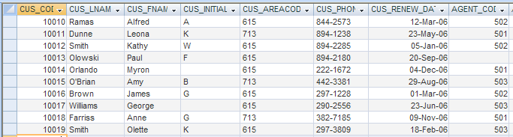
Orphaned records
In this case, customer number 10013 is an orphaned record because there is not a value in the Agent_Code Foreign Key field linking the record to a corresponding Primary Key in the sales agent table.

